Slide 1



Async all the way down
C Daniel Waddell

Slide 2








We are exceptional at:
ADVISORY SERVICES
APPLICATION DEVELOPMENT
MOBILE SOLUTIONS
DATA & ANALYTICS
We’re an IT solutions company that solves tough technology challenges so you can get back to business better than usual.
INTERNET OF THINGS
APPLICATION MANAGEMENT
TESTING SERVICES
PLATFORM SERVICES

Slide 3






About Me
I have been developing software commercially for the last 15 year. In my free time I enjoy mixing live music for local Louisville bands, making movies, and developing video games.
https://github.com/cdwaddell
https://www.linkedin.com/in/cdwaddell
@cdanielwaddell

Slide 4
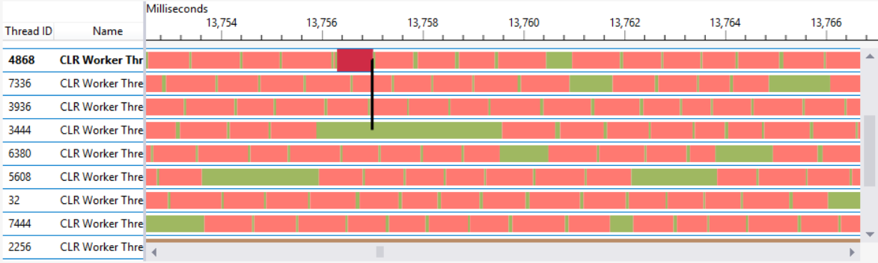
Multi-Threading
App threads are functionally the same as OS Threads.
Tasks are wrappers around threads.
You can use the Concurrency Visualizer to see threads (not available in VS 2019 or for Web).

Slide 5
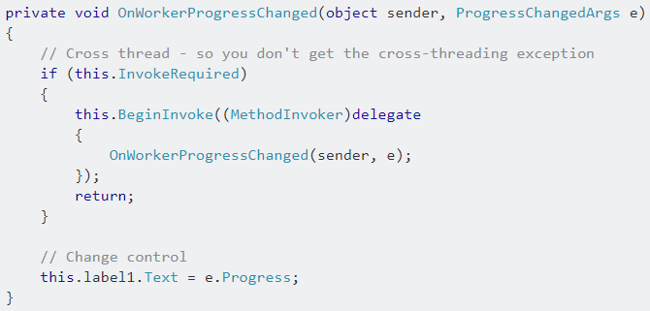
Origins of async/await and UI heavy applications
In many applications with a main UI thread, if your UI thread is ever halted then your application will become unresponsive. And you can not modify anything on the UI thread outside of that thread.
Notes:
Async/Await origins

Slide 6
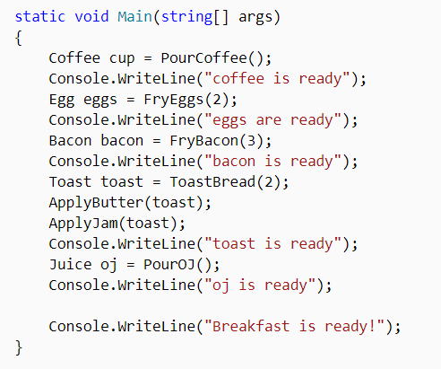
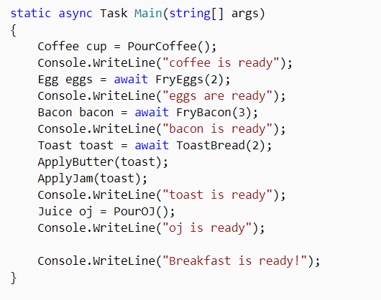
What is async/await in C#
Multi-threading made easy*

Slide 7
What is a Synchronization Context?
Abstractions, abstractions, abstractions …
Provides the basic functionality for propagating a synchronization context in various synchronization models. The purpose of the synchronization model implemented by this class is to allow the internal asynchronous/synchronous operations of the common language runtime to behave properly with different synchronization models. This model also simplifies some of the requirements that managed applications have had to follow in order to work correctly under different synchronization environments.
It exists because we need a way to communicate between threads.
Every Thread has its own SynchronizationContext.
The AspNetSynchronizationContext was removed in ASP.NET Core.

Slide 8
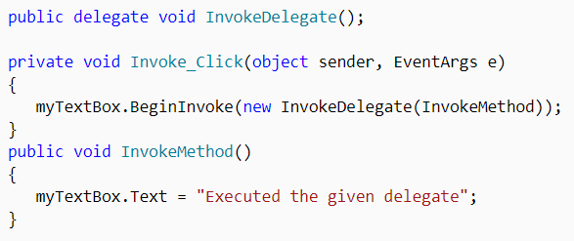
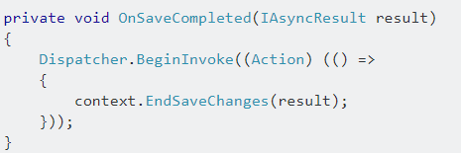
Synchronization Context is just another abstraction
Windows Forms
WPF

Slide 9
Synchronization context & ASP.Net
ASP.Net Core does not have a synchronization context, but ASP.Net does.
Used to isolate the static HttpContext.Current of each request.
Guarantees that the User is set for the entirety of the threaded request.
Causes deadlocks when mixing async and sync code, Core programmers will scratch their heads.
Actually ASP.Net has a second optional Synchronization context that makes it a little friendlier called “UseTaskFriendlySynchronizationContext”
Be careful using HttpContext.Current in async libraries with ConfigureAwait(false).

Slide 10
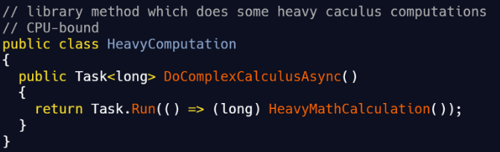
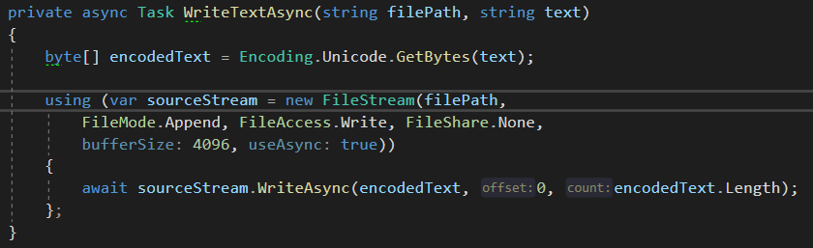
Async all the way down?
CPU Bound Code
I/O Bound Code
Use Task.Run(…) to execute things in parallel.
This comes at thread management cost.
This is for off-loadability not scalability.
I/O Bound async contributes to massive scalability in your apps.
Any library code that has I/O bound work should be async.

Slide 11
Demo

Slide 12
Rules for using async/await
Do not mix sync and async code
Avoid async void
Deadlocking can occur or you lose the benefits of async operations.
You will lose your ability to catch an Exception.
Don’t make CPU-bound Tasks libraries
ConfigureAwait(false) in libraries
Your consumers should decide about async vs sync.
This keeps consumers of your code from having deadlocks if the mix sync and async.
Task.Run() for parallel operations
CPU bound work can be run in a Task.Run to increase responsiveness, but it does not make your code more efficient unless your CPU is under utilized.
Beware of implicit parallelism
With Threadpool, async code may run out of order.

Slide 13
ASP.Net Core is Awesome
Hold on, not so fast!
Asp.Net Core is designed for scalability and is designed with async in mind, so they have limited the number of “chefs in the kitchen” so thread starvation is your enemy.
Threads are added to the pool at around 2 per second, so recreating production scaling issues is hard.
.Net Core 2+ allows you to control the number of threads, but it comes at the cost of 1GB/1000 threads.
So how do we avoid this situation?
For CPU bound work, do not use async if you need to scale.
For I/O bound work, always use async controller actions and await all I/O operations. If you are using an I/O bound library that doesn’t use async, then find another library.
None of the guidelines here apply to ASP.Net Core, so we can go wild wild west with async/await! err…

Slide 14
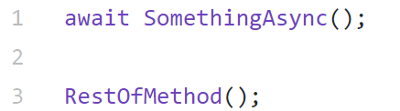
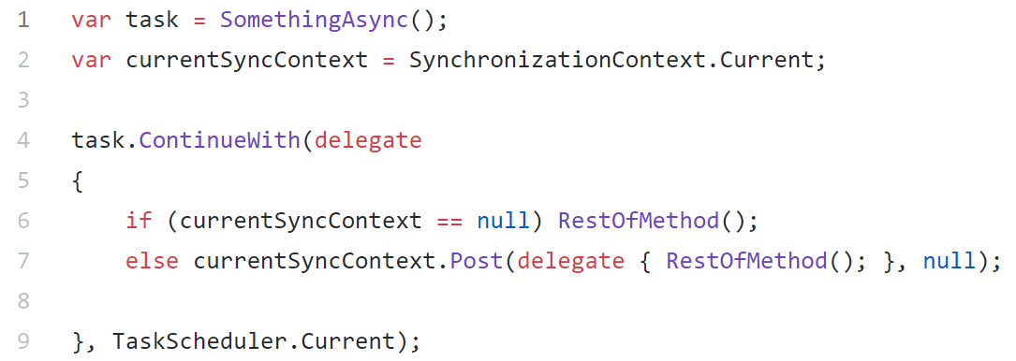
In the end it is all syntactic sugar

Slide 15
Questions?

Slide 16


Slide 17
Sources
https://msdn.microsoft.com/magazine/gg598924.aspx
https://www.productiverage.com/i-didnt-understand-why-people-struggled-with-nets-async
https://codeblog.jonskeet.uk/category/eduasync/
https://blog.stephencleary.com/2017/03/aspnetcore-synchronization-context.html
https://msdn.microsoft.com/en-us/magazine/jj991977.aspx
https://docs.microsoft.com/en-us/dotnet/csharp/programming-guide/concepts/async/using-async-for-file-access
https://docs.microsoft.com/en-us/dotnet/api/system.threading.tasks.task.run?view=netframework-4.8
http://vegetarianprogrammer.blogspot.com/2012/12/understanding-synchronizationcontext-in.html
https://blogs.msdn.microsoft.com/benwilli/2015/09/10/tasks-are-still-not-threads-and-async-is-not-parallel/

